Slide 1
Operator Overloading

Slide 2
Operator Overloading
The method of defining additional meanings for operators is known as operator overloading
Enables an operator to perform different operations depending upon the type of operands
The basic operators i.e. +, -, *, / normally works with basic types i.e. double, float, int, long. (defined in C++)
So, how can these operators can be applied to user-defined data types?

Slide 3
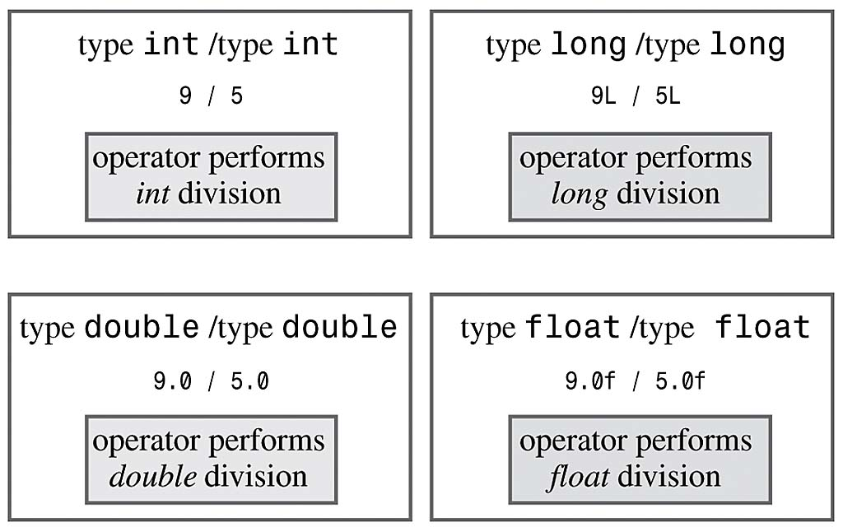
Operator Overloading
Example (already overloaded operator):

Slide 4
How to Overload an Operator?
An operator can be overloaded by declaring a special member function in the class
Name of the member function is operator that is followed by operator symbol e.g., operator+, operator/, etc.
Notes:
Can be a member function (must be non-static): to be able to work on objects of the class
If you plan on implementing ->, () or [] they are naturally member methods.
The binary operators = (assignment), [] (array subscription), -> (member access), as well as the n-ary () (function call) operator, must always be implemented as member functions, because the syntax of the language requires them to.

Slide 5
Syntax to Overload an Operator
returnType operator opsymbol(parameters){ }
↑ ↑ ↑ ↑ any type keyword operator symbol function body
return-type may be whatever the operator returns
Operator symbol may be any overloadable operator
Example:
void operator+ (parameters){ }
↑ ↑ ↑ ↑ any type keyword operator symbol function body

Slide 6
Operator Overloading
Operators are really functions
They have arguments, they return values
The only difference is that their names take on a specific form:
Operator+, operator[ ]
Overloading provides concise notation:
// without operator overloading object2 = object1.add(object2);
// with operator overloading
object2 = object2 + object1;

Slide 7
Restriction on Operator Overloading
With operator overloading we cannot change:
How operators act on built-in data types:
i.e., cannot change integer addition
Precedence of operator (order of evaluation)
Use parentheses to force order-of-operations
Association rules (left-to-right or right-to-left evaluation)
Number of operands
i.e., & is unary, only acts on one operand
Cannot create new operators
Operators must be overloaded explicitly:
i.e., Overloading + , does not overload +=
Notes:
at least one of the operands has to be of a user-defined type.

Slide 8
Restriction on Operator Overloading
http://www.stroustrup.com/bs_faq2.html#overload-dot
Notes:
The comma operator (represented by the token, ) is a binary operator that evaluates its first operand and discards the result, it then evaluates the second operand and returns this value (and type). The comma operator has the lowest precedence of any C operator, and acts as a sequence point.
->* is an operator to operate on function pointers
https://isocpp.org/wiki/faq/operator-overloading#overload-dot
http://www.stroustrup.com/bs_faq2.html#overload-dot
There is no fundamental reason to disallow overloading of ?:. I just didn't see the need to introduce the special case of overloading a ternary operator. Note that a function overloading expr1?expr2:expr3 would not be able to guarantee that only one of expr2 and expr3 was executed.
Sizeof cannot be overloaded because built-in operations, such as incrementing a pointer into an array implicitly depends on it. Consider:
Operator . (dot) could in principle be overloaded using the same technique as used for ->. However, doing so can lead to questions about whether an operation is meant for the object overloading . or an object referred to by . For example:

Slide 9
Operator =, operator &
Operator = and operator & are overloaded implicitly for every class, so they can be used for each class objects.
operator = performs member-wise copy of the data members.
operator & returns the address of the object in memory.

Slide 10
Function Overloading
An overloaded function is one which has the same name but several different forms.
For example: we can overload the constructor for the Date class:
default Date d;
initializing Date d(9,22,20);
copy Date d1(d);
other Date d(“Sept”,22,2020);

Slide 11
Operator Overloading
The operator “+” also has different semantics depending on the type of its “arguments”
Example
int i, j;
double d, e;
i + j; //add two int
i + d; //add an int and a double

Slide 12
Operator Overloading Syntax
a = b + c;
datatype operator + (datatype) { … }
Second parameter (can be native data type or user defined data type)
Remember operator+ is a function, and it will be called with the help of any object, thus the first parameter is the calling object
return parameter
(can be native data type or user defined data type)

Slide 13
Operator Overloading Syntax
datatype operator+ (datatype) { }
Example (1):
class myClass
{
int operator+ ( int );
}
int main ( )
{
int a, b;
myClass object;
a = object + b;
}

Slide 14
Operator Overloading Syntax
datatype operator+ (datatype)
Example (2):
class myClass
{
int operator+ ( myClass &a );
}
int main ( )
{
int a;
myClass object1, object2;
a = object1 + object2;
}

Slide 15
Operator Overloading Syntax
datatype operator+ (datatype)
Example (3):
class myClass
{ myClass operator+ ( int ); }
int main ( )
{
int a = 5;
myClass object1, object2;
object2 = object1 + a;
}

Slide 16
Operator Overloading Syntax
datatype operator+ (datatype)
Example (4):
class myClass
{
myClass operator+ ( myClass &a );
}
int main ( )
{
myClass object1, object2, object3;
object3 = object1 + object2;
}

Slide 17
Implementing Overloaded Operators
The compiler uses the types of arguments to choose the appropriate overloading.
int v1, v2;
v1 + v2; // int +
float s1, s2;
s1 + s2; // float+

Slide 18
Extended Example
Employee class and objects
class Employee
{
private:
int idNum;
double salary;
public:
Employee(int id, double salary);
double addTwo (Employee& emp);
double operator+ (Employee& emp);
double getSalary() { return salary; }
};

Slide 19
The member functions ‘addTwo’ and operator+
//function notation
double Employee::addTwo(Employee& emp)
{
double total;
total = this->salary + emp.getSalary();
return total;
}
//operator overloading notation
double Employee::operator+(Employee& emp)
{
double total;
total = this->salary + emp.getSalary();
return total;
}

Slide 20
Using the Member Functions
double sum;
Employee Clerk (111, 10000), Driver (222, 6000);
// these three statements do the same thing
sum = Clerk.addTwo(Driver);
sum = Clerk.operator+(Driver);
sum = Clerk + Driver;
// the syntax for the last one is the most natural
// and is easy to remember because it is consistent
// with how the + operator works for everything else

Slide 21
Multiple Operators
Often, you may need to reference an operator more than once in a expression:
Example:
total = a + b + c;
But this can cause big problems when operator overloading is involved
See next example…

Slide 22
Client Code for Class Employee
void main()
{
Employee Clerk(115, 20000.00);
Employee Driver(256, 15500.55);
Employee Secretary(567, 34200.00);
double sum;
sum = Clerk + Driver + Secretary;
cout << “Sum is “ << sum;
}

Slide 23
The Problem
Operator + is left to right associative, so Clerk and Driver are added. The result is a double.
Now that double is on the left and an Employee is on the right (i.e., Secretary)
BUT THE OPERATOR + is only defined for arguments of type Employee, not for double
Notes:
To do:
?? = int + object
but this one allows the int to come first in the call friend Fraction operator+(int n, Fraction f);
Note that these last two are not really needed in the Fraction class, since we have a conversion constructor! The normal operator+ function: friend Fraction operator+(const Fraction& f1, const Fraction& f2);

Slide 24
The Problem Gets Worse
It would seem that all we have to do is write another version of the overloaded operator to work with the argument (double)
But…
although we could overload an operator to work like this:
sum = Secretary + num;
We cannot overload (with member function) one like this:
sum = num + Secretary; // why not?
Notes:
Because:
sum = Secretary + num; → Employee class is called (with object Secretary) and double is passed as argument
sum = num + Secretary; → num is double (we cannot call + overloaded operator with a double value) and pass class Employee object [This is how we defined class]

Slide 25
The Answer
We cannot overload + for a double (a native type)
The real solution is to make sure that your operator+ function never returns a double (or any other native type).
An operator to add Employees should return an Employee (see next slide)

Slide 26
Extended Example
Employee class and objects
class Employee
{
private:
int idNum;
double salary;
public:
Employee(int id, double salary);
Employee operator+ (Employee& emp);
double getSalary() { return salary; }
}

Slide 27
Solution Example
Employee Employee::operator+(Employee& emp)
{
Employee total(999,0); // dummy values
total.salary = salary + emp.salary;
return(total);
}

Slide 28
Client Code for Class Employee
void main()
{
Employee Clerk(115, 20000.00);
Employee Driver(256, 15500.55);
Employee Secretary(567, 34200.00);
Employee sum(0, 0.0);
sum = Clerk + Driver + Secretary;
}

Slide 29
Invoking Objects
If the operator is binary but there is only one explicit argument, the ‘invoking instance’ is assumed to be the one on the left hand side of the expression.
class Date
{
public: // member functions
Date operator=(Date& d);
};
int main (void)
{
s1 = s2; // instead of s1.operator=(s2);
}

Slide 30
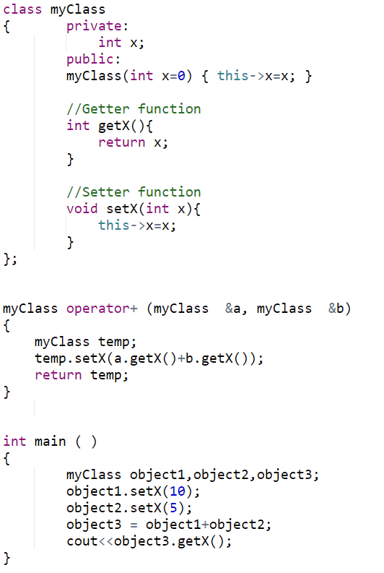
Non-member Operator Overloading Function

Slide 31
The Answer (double+object)
We cannot overload + for a double (a native type)
The real solution is to make sure that your operator+ function never returns a double (or any other native type).
An operator to add Employees should return an Employee (see next slide)
Solution 2: make a non-member operator overloading function.

Slide 32
Assignment Operator =
Operator = is overloaded implicitly for every class, so they can be used for each class objects.
operator = performs member-wise copy of the data members.
However, there is a problem with implicitly overloaded operator…(see next slide)
Notes:
Yes, if class contains pointers (dynamic allocations) to ensure a Deep Copy

Slide 33
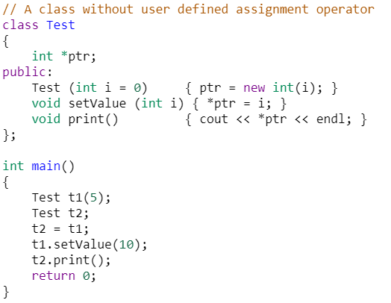
Using implicit Overloaded Assignment Operator
Notes:
Output = 10
https://www.geeksforgeeks.org/assignment-operator-overloading-in-c/

Slide 34
Operator Overloading – Part 2

Slide 35
Operator Overloading – Review
The variables of native data types can perform a number of different operations (functions) using operators ( +, - , / , *, etc)
Example: a + b * c
Example: if ( a < b )
However, with user defined (classes) objects we can not use operators:
Example: class obj1, obj2;
if ( ob1 < obj2 )

Slide 36
Operator Overloading – Review
To add operator functionality in the class
First create a function for the class
Set the name of the function with the operator name
operator + for the addition operator ‘+’
operator > for the comparison operator ‘>’

Slide 37
Extended Example
Employee class and objects
class Employee
{
private:
int idNum;
double salary;
public:
Employee(int id, double salary);
Employee operator+ (Employee& emp);
double getSalary() { return salary; }
};

Slide 38
Solution Example
Employee Employee::operator+(Employee& emp)
{
Employee total(999,0); // dummy values
total.salary = salary + emp.salary;
return(total);
}

Slide 39
Client Code for Class Employee
void main()
{
Employee Clerk(115, 20000.00);
Employee Driver(256, 15500.55);
Employee Secretary(567, 34200.00);
Employee sum(0, 0.0);
sum = Clerk + Driver + Secretary;
}

Slide 40
Overloading > operator
bool Employee::operator>(Employee& e)
{
return(seniority > e.seniority);
}
called from the program like this:
if (emp1 > emp2)

Slide 41
Operator Overloading Syntax
Although, the syntax of defining prototype:
datatype operator+ (datatype)
However, for some operators, there is little bit change in the above syntax:
++, -- operators
>>, << operators
& and [ ] operators

Slide 42
Overloading ++ and --
Operator ++ and -- are different to other operators of C++
We can call them:
either in the form of prefix (++i) before an object
or in the form of postfix (i++) after an object
But in both cases, the calling object will be i.

Slide 43
i++ and ++i ?
Prefix makes the change, and then it processes the variable
Postfix processes the variable, then it makes the change.
i = 1;
j = ++i;
(i is 2, j is 2)
i = 1;
j = i++;
(i is 2, j is 1)

Slide 44
Overloaded ++
class Inventory
{
private:
int stockNum;
int numSold;
public:
Inventory(int stknum, int sold);
void operator++();
};
void Inventory::operator++()
{
numSold++;
}

Slide 45
Use of the operator ++
int main ( )
{
Inventory someItem(789, 84);
// the stockNum is 789
// the numSold is 84
++someItem;
Inventory Item2 = ++someItem;
//will this instruction work
}
Notes:
Inventory Item 2 = ++someItem; // Will not work as the overloaded function does not return anything

Slide 46
Overloaded ++
class Inventory
{
private:
int stockNum;
int numSold;
public:
Inventory(int stknum, int sold);
Inventory& operator++();
};
Inventory& Inventory::operator++()
{
Inventory *object = new Inventory(0,0);
numSold++;
object->numSold = numSold;
return(*object);
}

Slide 47
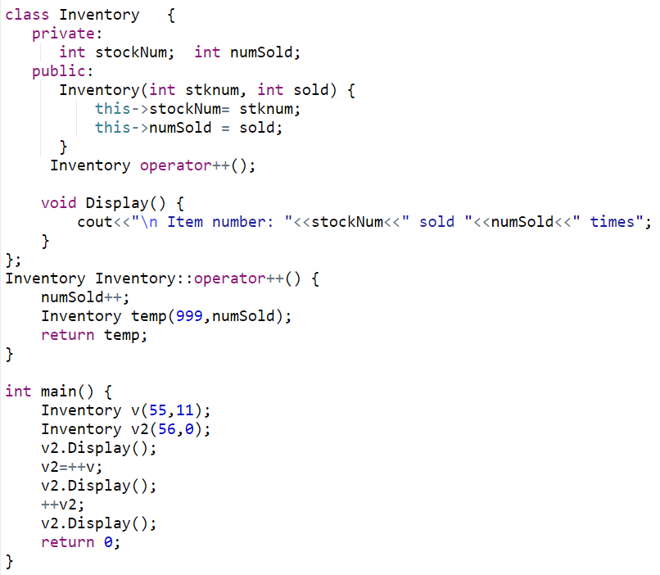
Using ++ (Prefix Notation)
Notes:
Item number: 56 sold 0 times
Item number: 999 sold 12 times
Item number: 999 sold 13 times

Slide 48
Problem
The definition of the prefix operator is easy enough. It increments the value before any other operation.
But, How will C++ be able to tell the difference between a prefix ++ operator and a postfix ++ operator?
Answer: overloaded postfix operators take a dummy argument (just for differentiation between postfix and prefix).

Slide 49
Postfix operator
Inventory& Inventory::operator++() // prefix version
{
Inventory *object = new Inventory(0,0);
numSold++;
object->numSold = numSold;
return(*object);
}
Inventory& Inventory::operator++(int) // postfix version
{
Inventory *object = new Inventory(0,0);
object->numSold = numSold;
numSold++;
return(*object);
}
dummy argument

Slide 50
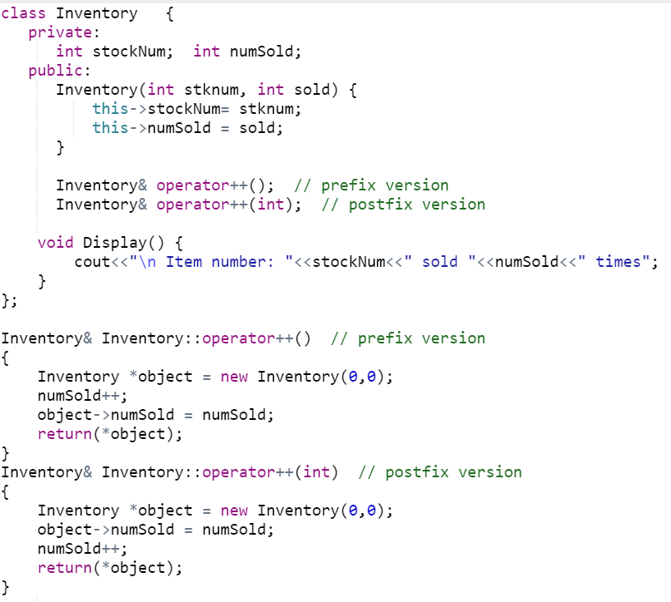
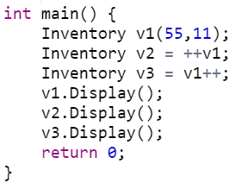
Postfix and Prefix ++
Notes:
Item number: 1 sold 13 times
Item number: 2 sold 12 times
Item number: 3 sold 12 times

Slide 51
Assignment Operator (=)
class Employee
{ private:
int idNum;
double salary;
public:
Employee ( ) { idNum = 0, salary = 0.0; }
void setValues (int a, int b);
void operator= (double );
}
void Employee::setValues ( int idN , double sal )
{
salary = sal; idNum = idN;
}
void Employee::operator = (double sal)
{ salary = sal; }

Slide 52
Assignment Operator (=)
int main ( )
{
Employee emp1;
emp1.setValues(10,33.5);
Employee emp2;
emp2 = 44.6; // emp2 is calling object
}

Slide 53
Assignment Operator (=)
class Employee
{ private:
int idNum;
double salary;
public:
Employee ( ) { idNum = 0, salary = 0.0; }
void setValues (int a, int b);
void operator= (Employee &emp );
}
void Employee::setValues ( int idN , double sal )
{ salary = sal; idNum = idN; }
void Employee::operator = (Employee &emp)
{ salary = emp.salary; }

Slide 54
Assignment Operator (=)
int main ( )
{
Employee emp1;
emp1.setValues(10,33.5);
Employee emp2;
emp2 = emp1; // emp2 is calling object
}

Slide 55
Comparison Operator (==)
class Employee
{ private:
int idNum;
double salary;
public:
Employee ( ) { idNum = 0, salary = 0.0; }
void setValues (int a, int b);
bool operator== (Employee &emp );
}
void Employee::setValues ( int idN , double sal )
{ salary = sal; idNum = idN; }
bool Employee::operator == (Employee &emp)
{ return (salary == emp.salary); }

Slide 56
Comparison Operator (==)
int main ( )
{
Employee emp1;
emp1.setValues(10,33.5);
Employee emp2;
emp2.setValues(10,33.1);
if ( emp2 == emp1 )
cout <<“Both objects have equal value”;
else
cout <<“objects do not have equal value”;
}

